Slide 1
0714 02 CSE 4103
Compiler Design

Slide 2
Transition Diagram

Slide 3
In compiler design, a transition diagram is a graphical representation of a finite automaton (FA) used mainly in the lexical analysis phase. It shows how the lexical analyzer moves between different states while reading characters from the source program to recognize tokens.
A transition diagram helps to:
Recognize lexemes (identifiers, keywords, numbers, operators, etc.)
Define token patterns using states and transitions
Implement lexical analyzers (scanners)
It is commonly derived from regular expressions.

Slide 4
Basic Components of Transition Diagram
A transition diagram consists of:
States
  Represented by circles
  One start state
  One or more final (accepting) states
Transitions
  Directed arrows between states
  Labeled with input symbols (characters)
Accepting States
  Indicate successful recognition of a token
  Often marked with double circles

Slide 5
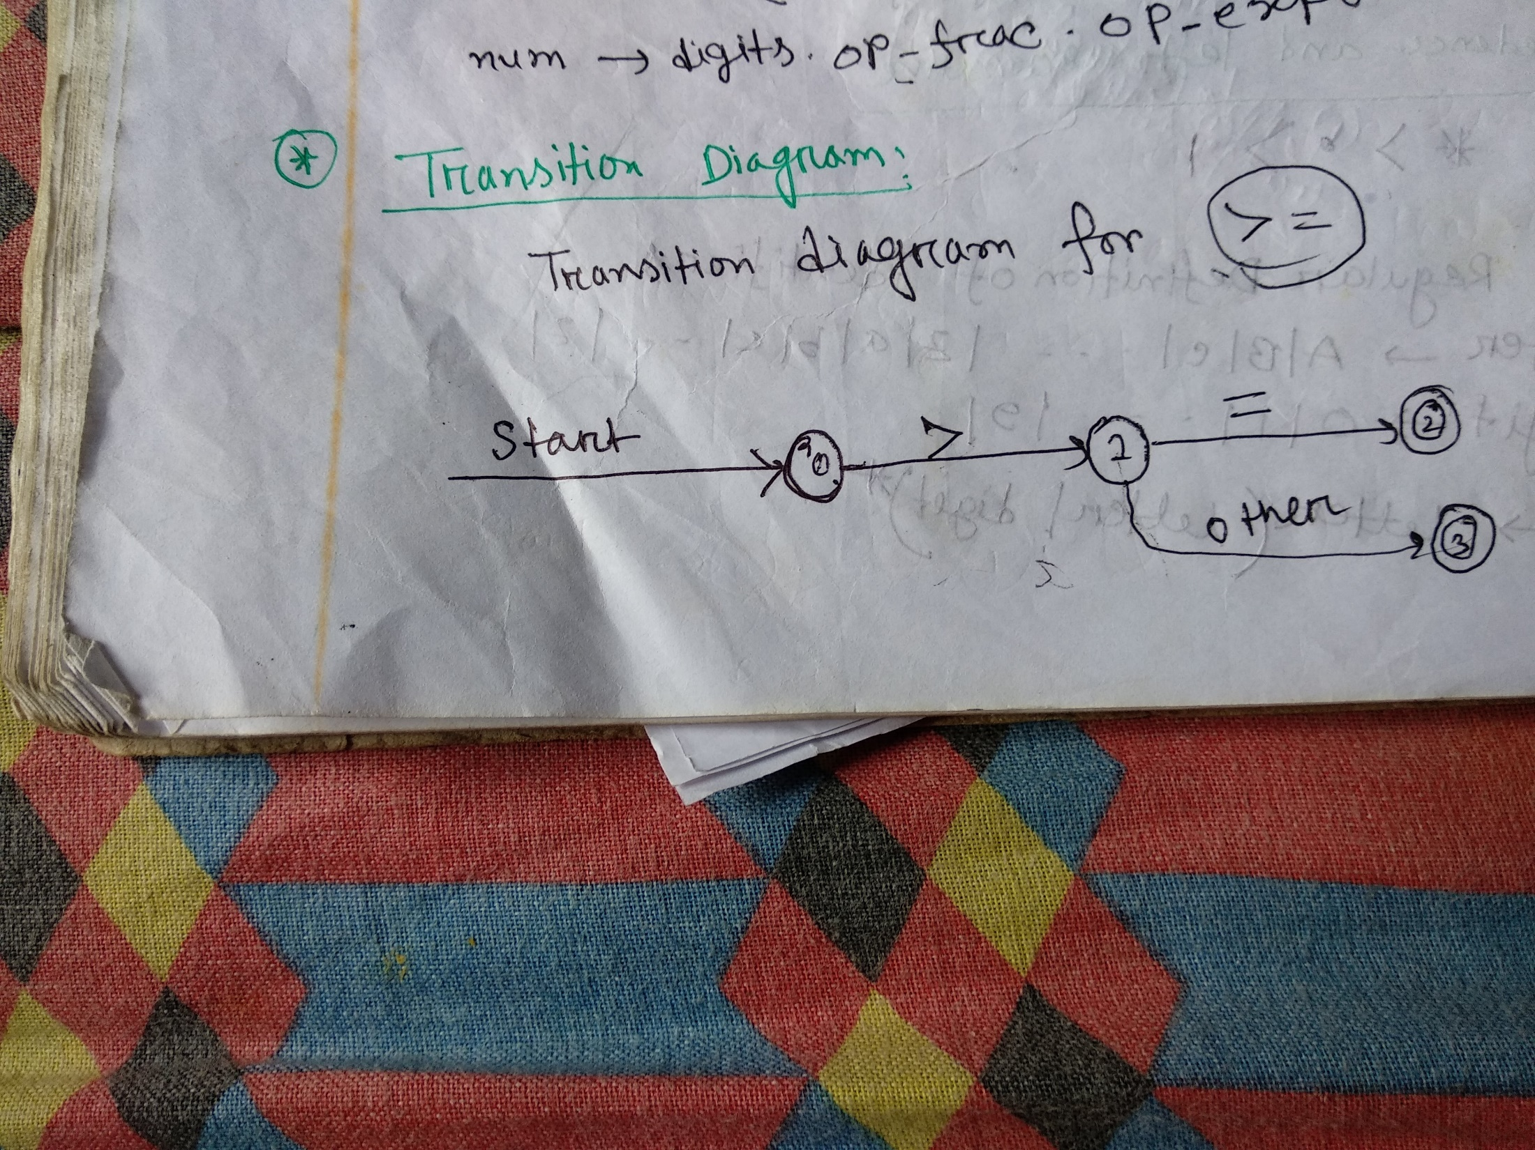

Slide 6
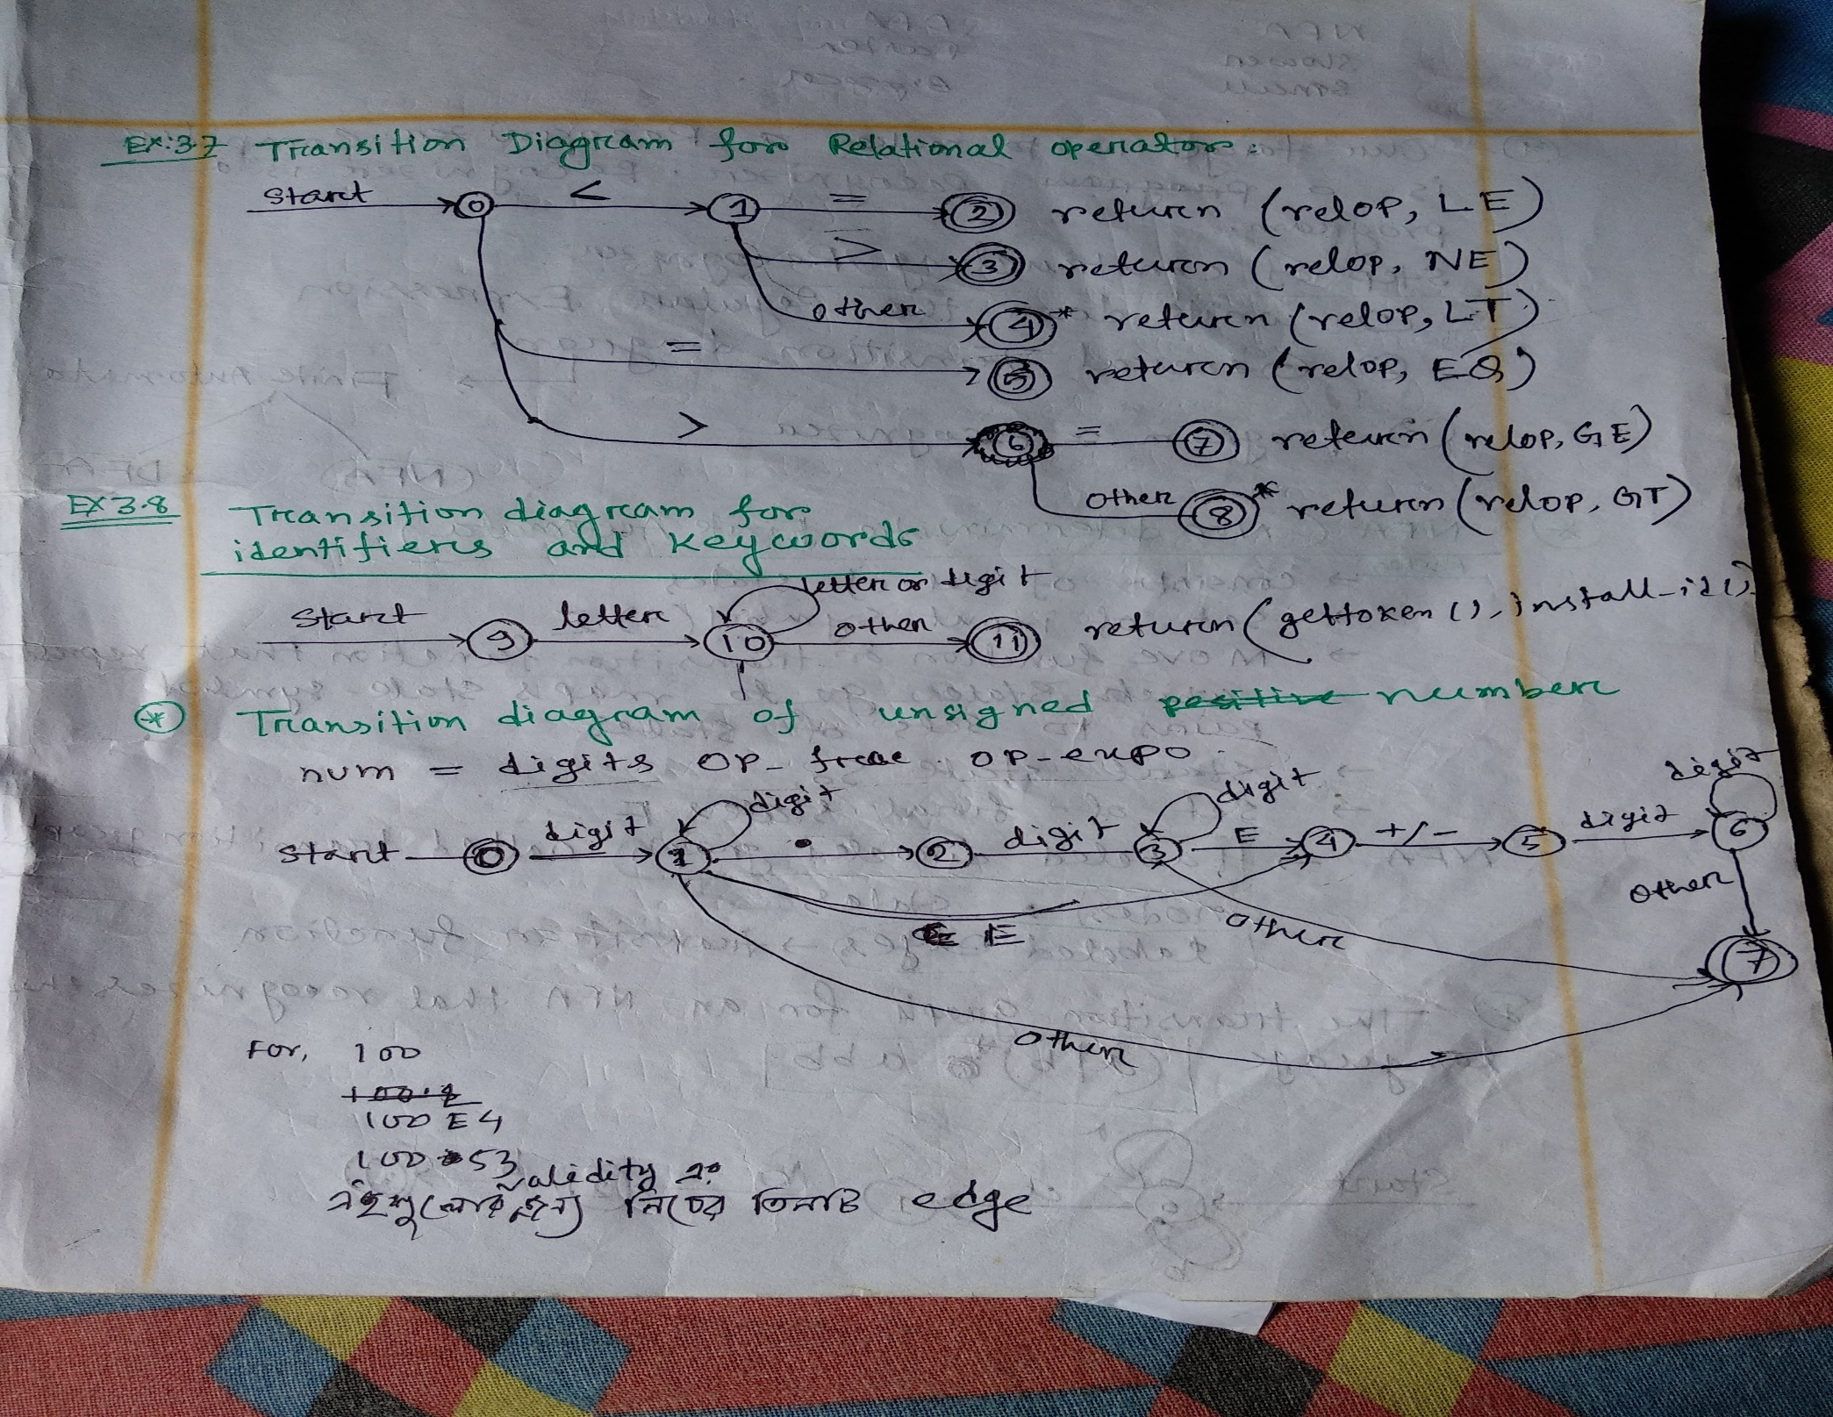

Slide 7
Thank You

